Slide 1
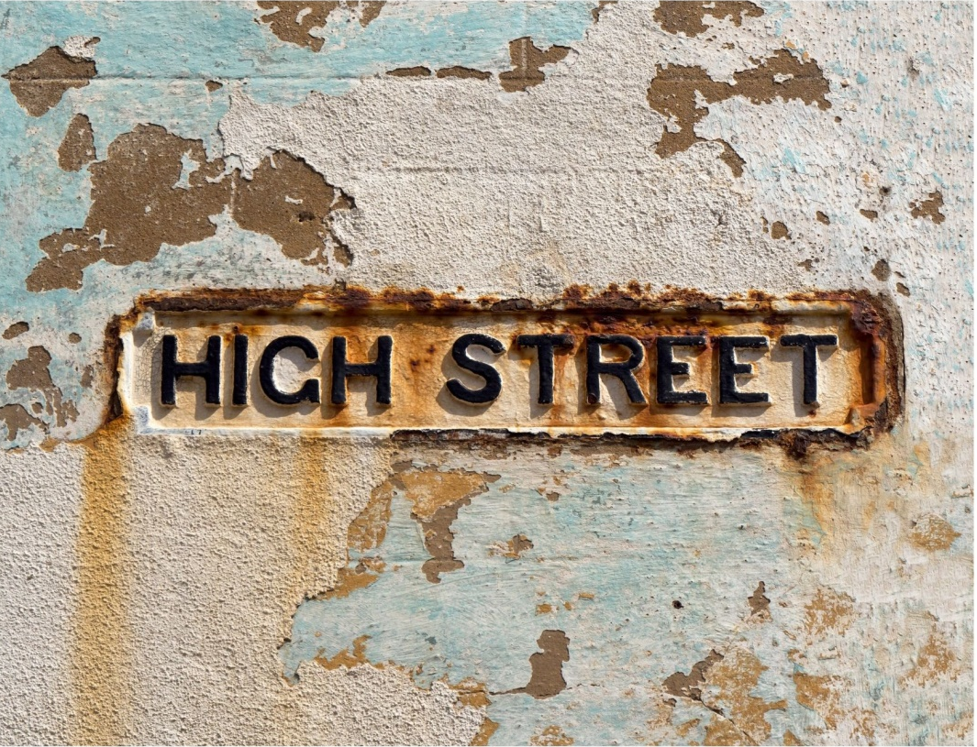
The High Street Shop - its vital role in the recovery of communities
By Steffi Stern

Slide 2
A little about me: Steffi Stern
Owner of retail craft shop
Entrepreneur
Published author
Public speaker
Designer Maker

Slide 3
Some Data
English and Welsh town centres have lost 8% of their shops on average since 2013, according to a Guardian analysis
Since 2010 nearly 1,400 retailers have entered administration
Since 2016 more shops have been closing than opening
‘We project that there could be a further 30,000 net store closures by the end of 2022’ (https://www2.deloitte.com/)
During the Pandemic nearly 50 shops per day closed their doors forever (20k shops closed during 2020)

Slide 4
Reasons behind the Decline of the UK High Street
More people shop online
Increase in business rates
Austerity / inflation
High rents
Out of town malls
Lack of infrastructure / parking
(reference: intechnologysmartcitis.com)

Slide 5
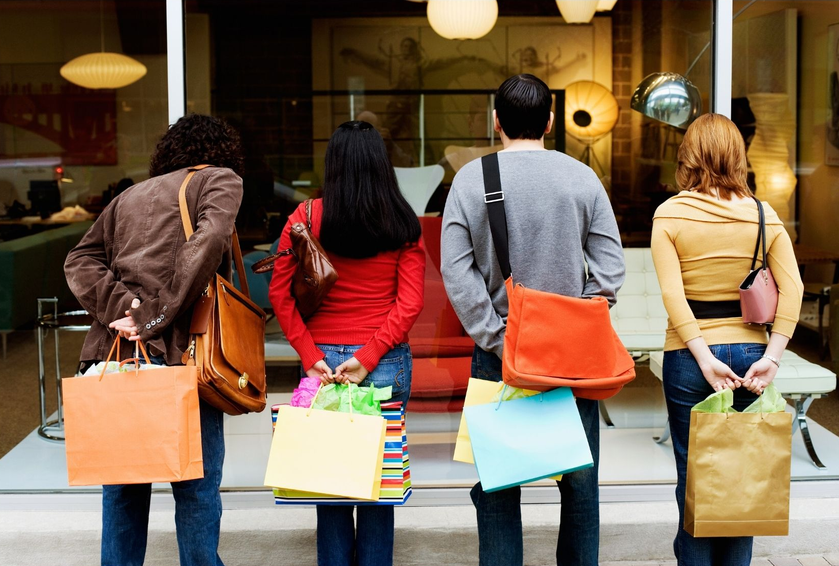
What makes you go to a shop?

Slide 6
Possible answers
Meet a friend or family member for a day out
Support local businesses
Carbon footprint
Buy made or sourced locally
Receive expert advice
Touch and feel what you buy
Easy returns
Unique / on of a kind products

Slide 7
Why have you stopped going to shops?

Slide 8
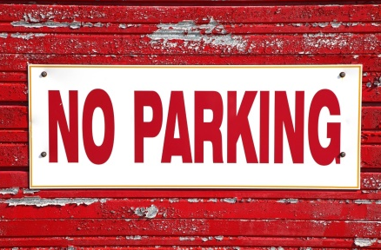
Possible Answers
Mental or physical health prevents going out
Restricted to opening hours
Too expensive
Can’t park or too expensive
Poor infrastructure – can’t get there
Online more convenient
last minute purchase

Slide 9
The High Street has a future (a view by Deloitte.com)
Low rents, prime locations available
Chance for diversity
High Street is capable of constant re-invention
The High Street is more than just about shopping – there are offices, flats and communal places = shoppers
Localisation trend
Trend from spending on ‘stuff’ has
changed to spending on ‘self’
https://www2.deloitte.com/uk/en/pages/consumer-business/articles/what-next-for-the-high-street.html
Notes:
Our view has not changed. While the rollcall of retail and leisure failures might suggest that the high street does not have a future, we would argue the opposite. We believe, the high street is ideally placed to reinvent itself in response to the structural shift in working and shopping patterns that has resulted from the COVID-19 pandemic. The perceived weaknesses of the high street model, its fragmented ownership, lack of centralised coordination, low rents and high vacancy rates become strengths as they lower the barriers to entry for new concepts and operators. They also enable experimentation and the fast failures that will ultimately lead to a more flourishing and diverse environment on our local high streets.

Slide 10
The Uk’s 50 most fabulous shops as reported by The Guardian Nov 2021
What makes them special and stand out?
Traditional skills
Artisan
Family feel
Experts in their field
Handmade
Using British products
Ethical policies (about products, people and environment)

Slide 11
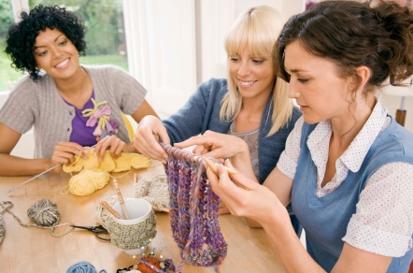
Why should I open a brick and mortar shop?
People are social ‘animals’: there will always be a place they want to hang out
Shop rentals are at their lowest and prime locations are available
Local town councils and chambers of commerce might be able to help promote your shop or help in other ways
Do what you love and love what you do – being a shop keeper is fun!
Be smart about your shop and you will see returns

Slide 12
Case Study: Merchant & Mills www.merchantandmills.com
Has everything a shop should have:
Clear and easy to use Website/online shop
Physical shop
Blog
Their story
Deliver locally as a service
Artisan look and family feeling
Social media
Run classes (YouTube)

Slide 13
Setting Expectations: It is hard work!
Be realistic
Test your product
Make sure you know your demographic
Use resources available: Growth Hub, Chamber of Commerce, Town Council, other shop owners
Be active locally (newsletter, local social media pages)
Be active on Social Media
See an online e-commerce presence as an opportunity rather than competition

Slide 14
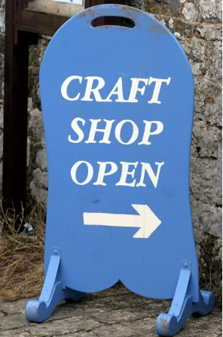
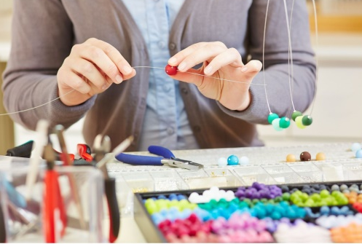
You can do it and have fun!
Make your shop a destination
Re-build communities
Be the expert and be generous with sharing what you know
Make a visit to your shop an experience
Upsell your services / products with other advantages: loyalty cards, classes, free demos, inviting experts, open evenings, social events, special days
Get to know your customers (newsletters, guest book, ask for online reviews)
Be different and use your creativity (shop window, display of products, finished samples)
Have an online presence to sell, communicate and be visible

Slide 15
Thank you for your attention
Please come and visit me to find out more about
The Makerss
We are at Stand A26

